Slide 1
Local Fabrication Roto Jet Pump

Slide 2
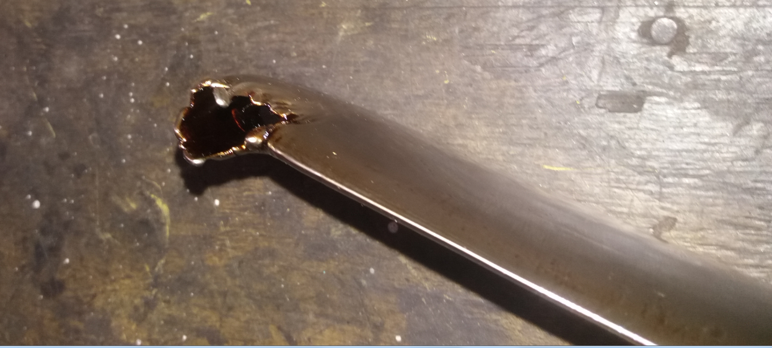
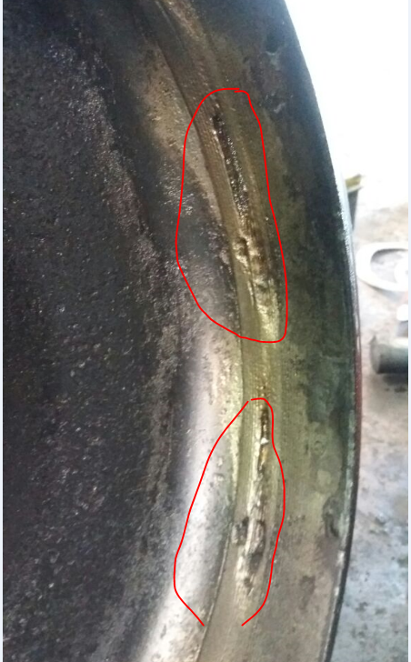
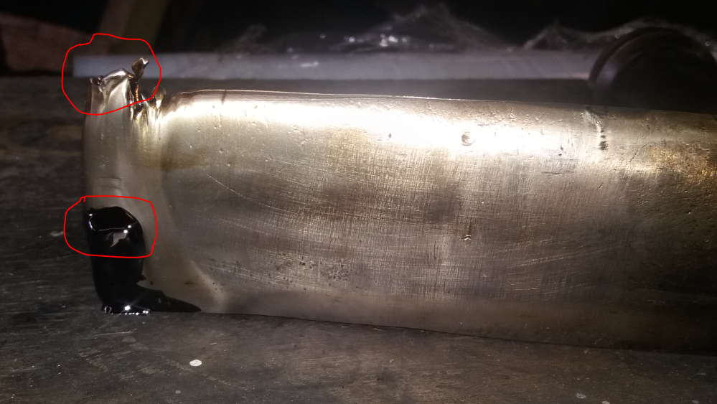
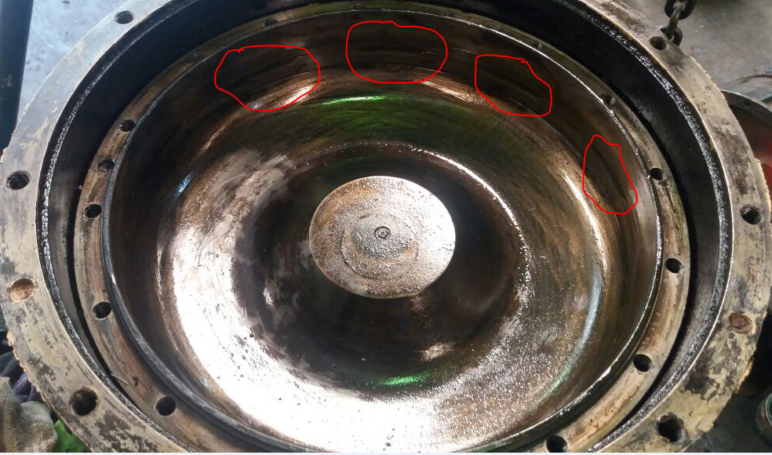
Background
Cilegon have a lot of rotojet pump that use for carbon black plant and EC, total CL have 7 pump 3 Feedstock pump, 2 quench pump and 2 BFW pump
CL have challenging problem with rotojet performance issue (pick up tube damaged and Rotor abrasion), almost every 3-4 months need to replace/repair rotojet pump that causing plant spent a lot of cost.
Pick Up tube damaged
Rotor abrasion

Slide 3
Best Practice
To optimize maintenance cost and reliability of rotojet pump, local team tried to do local fabrication for rotojet pump, the practice are :
Best Practice | Spare part to be repair | Original cost, $ | Local Fabrication cost, $ | Saving, $
Welding repair and hardening | Pick up tube damaged |  | 160
Metal spray | Rotor abrasion |  | 1150
Fabrication | New pick up tube |  | 1920
This practice can give some benefit :
Maintenance cost saving
More reliable rotojet pump
Lower spare part lead time and short maintenance activity

Slide 4
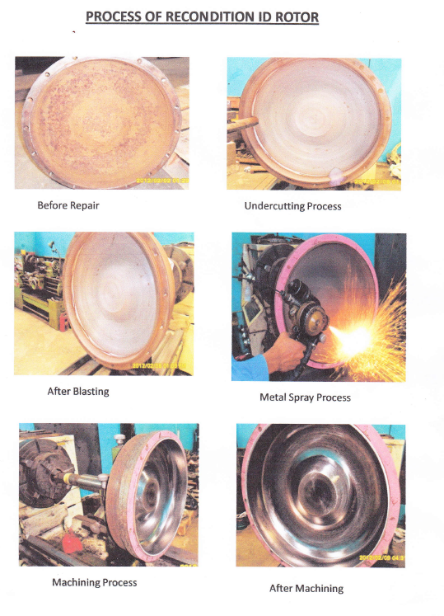
Rotor Metal Spray

